Slide 1
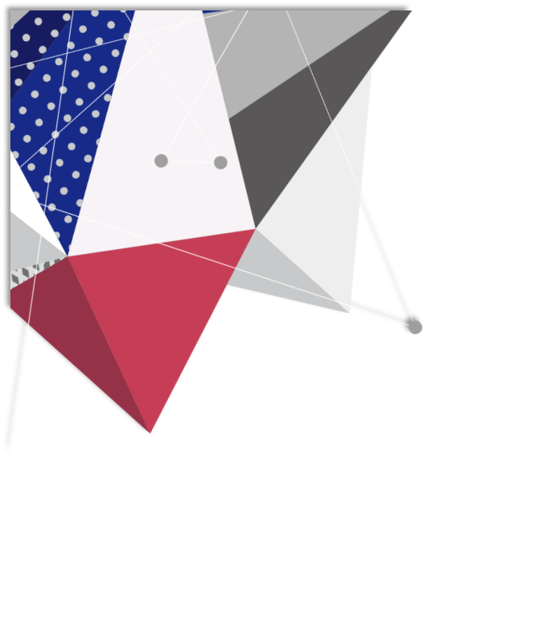
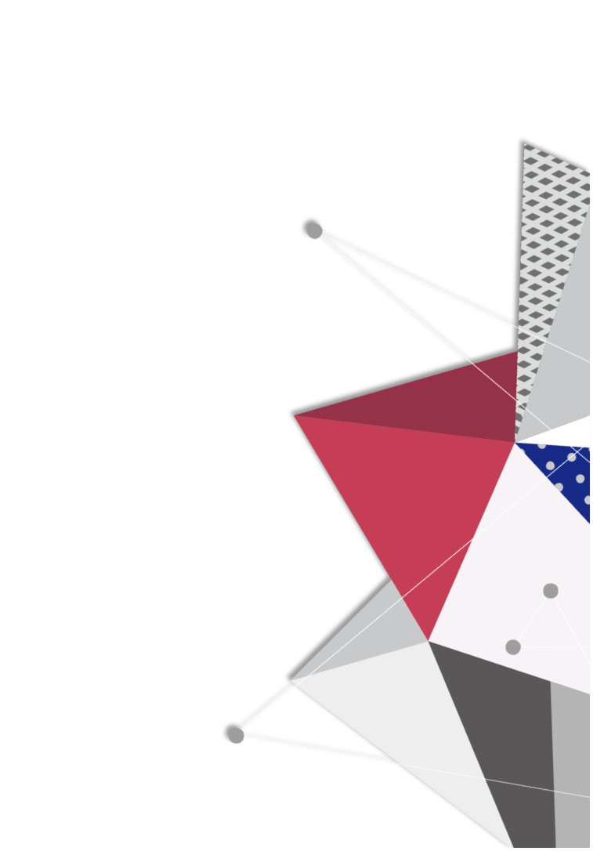
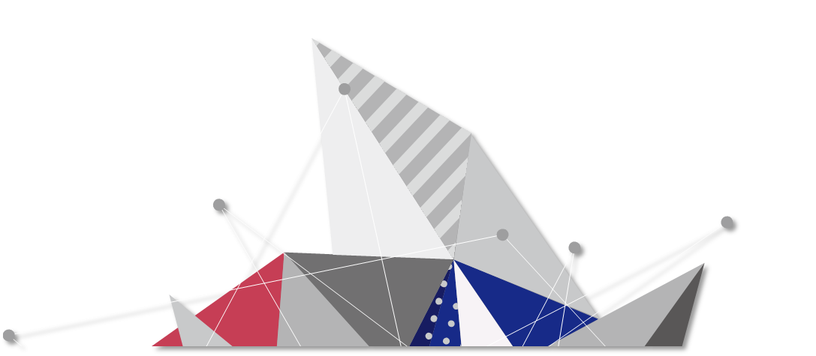
TIME TRAVEL
SYSU CG
GROUP 16

Slide 2
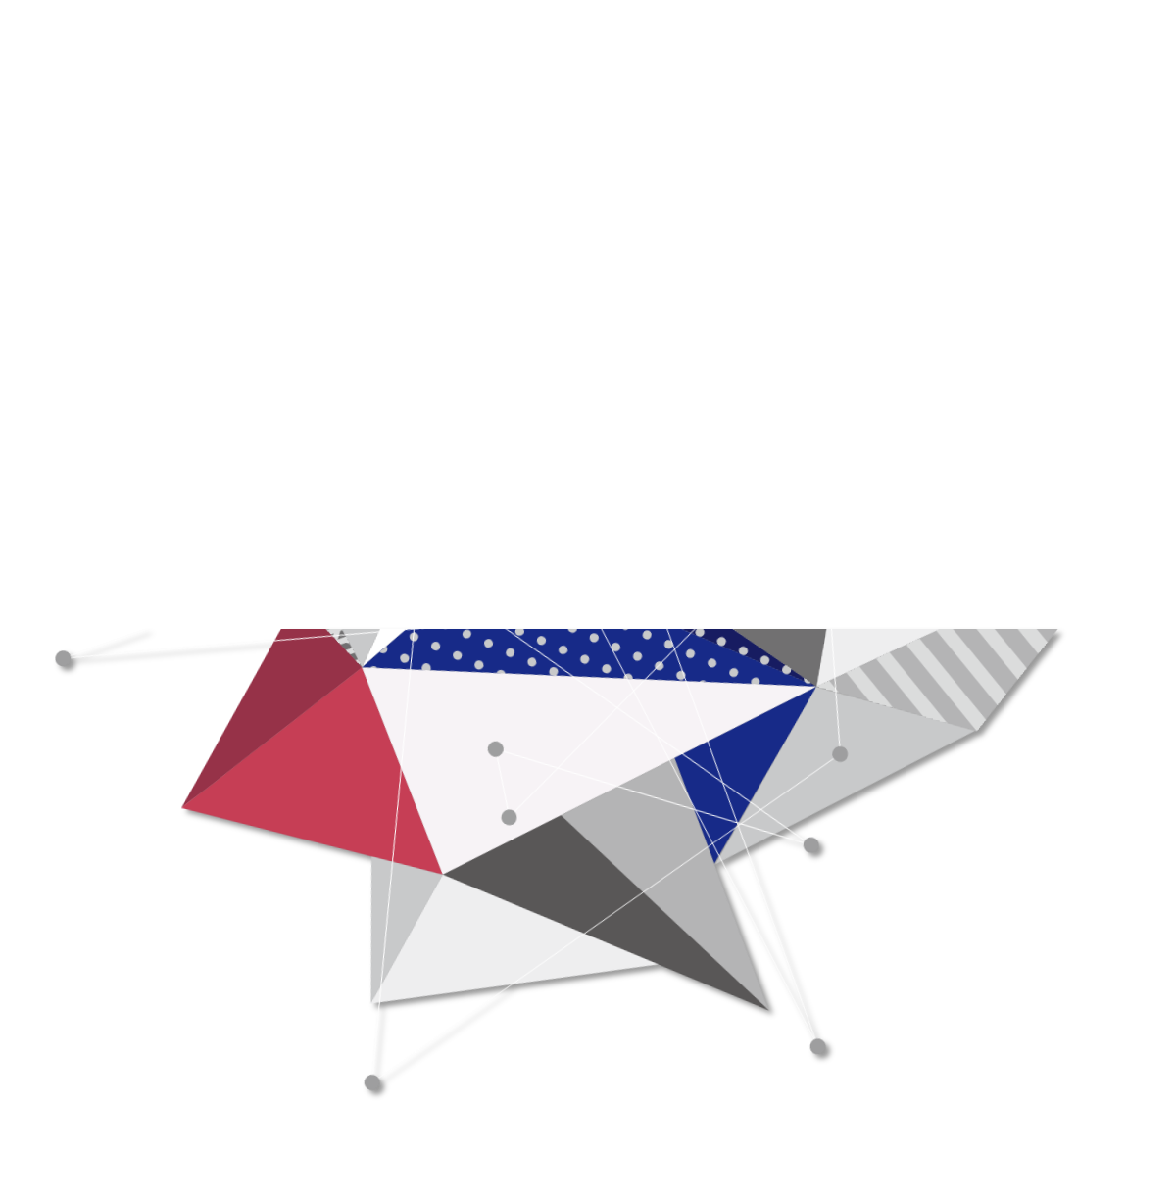
主题
进度
CONTENTS
分工
I believe that for his escape he took advantage of the migration of a flock of wild birds. On the morning of his departure he put his planet in perfect order.
安排

Slide 3
主题
进度
CONTENTS
分工
I believe that for his escape he took advantage of the migration of a flock of wild birds. On the morning of his departure he put his planet in perfect order.
安排

Slide 4
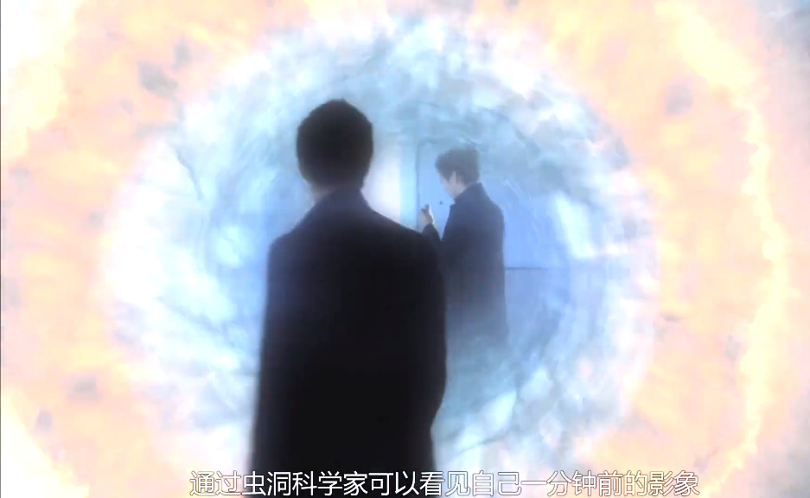
时空穿梭
背景介绍
虫洞猜想：生活中处处充满了黑洞，只不过它们小到我们肉眼不可见，霍金的一部纪录片提到，穿越虫洞，我们便能时间旅行，回到过去或者达到未来。

Slide 5
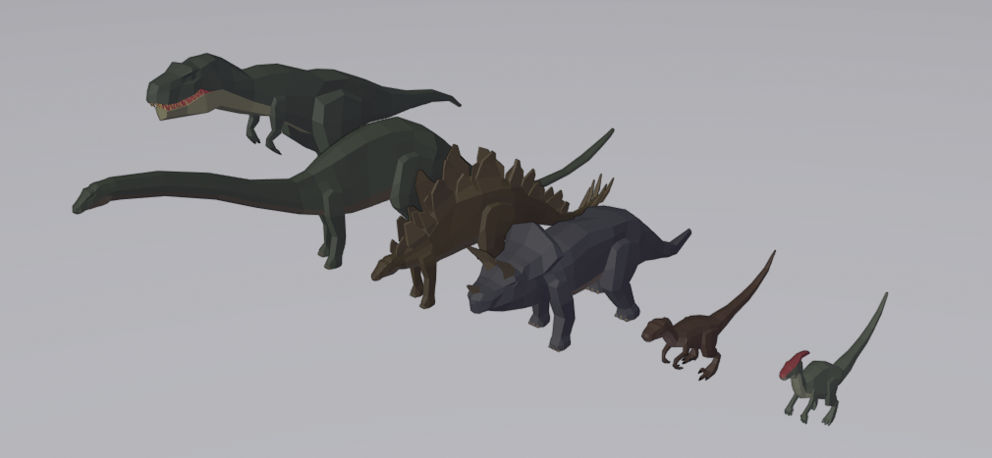
过去
该场景的标志物为恐龙

Slide 6
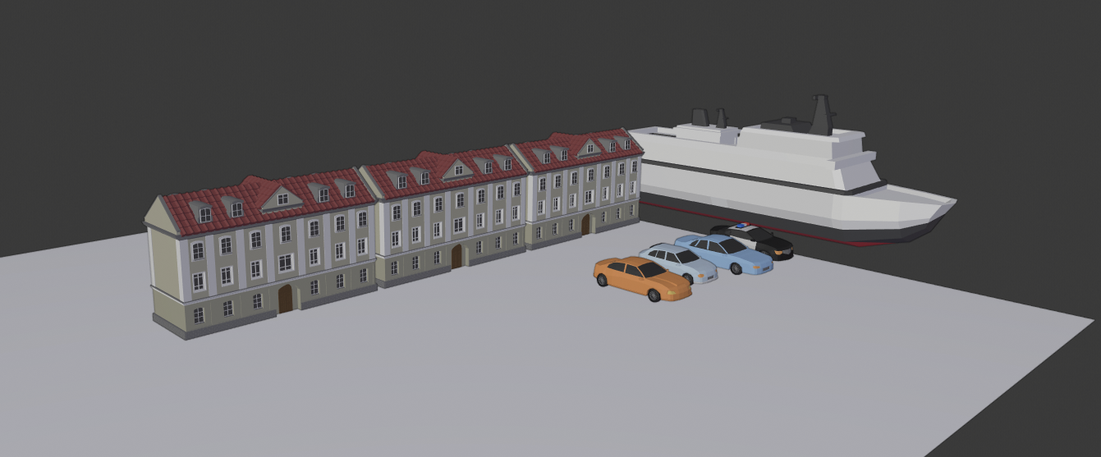
现在
该场景的标志物楼房、车辆、船

Slide 7
未来
待定。初步的想法是环境被破坏

Slide 8
主题
进度
CONTENTS
分工
I believe that for his escape he took advantage of the migration of a flock of wild birds. On the morning of his departure he put his planet in perfect order.
安排

Slide 9
目前进度
确定动画风格：low-poly
确定动画视角：飞行器
确定场景主题：时间旅行
正在学习blender、OpenGL的骨骼动画制作
场景正在搭建

Slide 10
主题
进度
CONTENTS
分工
I believe that for his escape he took advantage of the migration of a flock of wild birds. On the morning of his departure he put his planet in perfect order.
安排

Slide 11
分工
黄俊凯、黄嘉杰：模型制作
黄俊杰、胡嘉鹏：使用OpenGL导入模型并创造可交互场景

Slide 12
主题
进度
CONTENTS
分工
I believe that for his escape he took advantage of the migration of a flock of wild birds. On the morning of his departure he put his planet in perfect order.
安排

Slide 13
安排
熟悉blender建模（1周）
建模（2周）
OpenGL可交互场景创建（3周）

